Slide 1


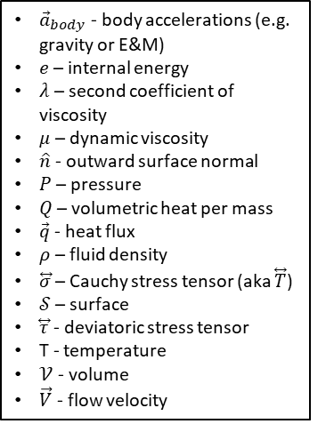
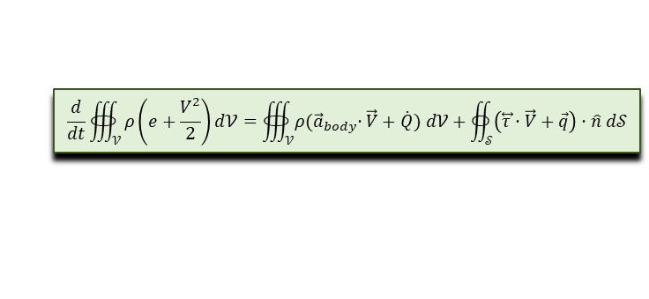

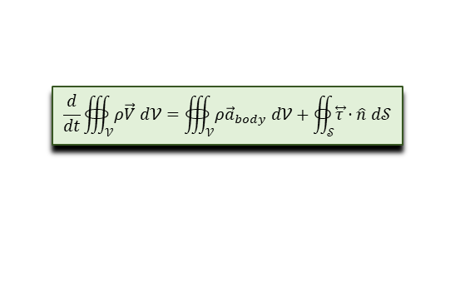

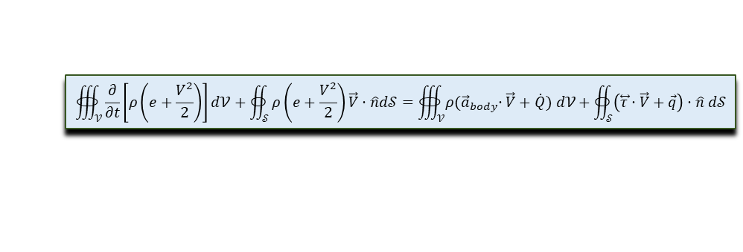





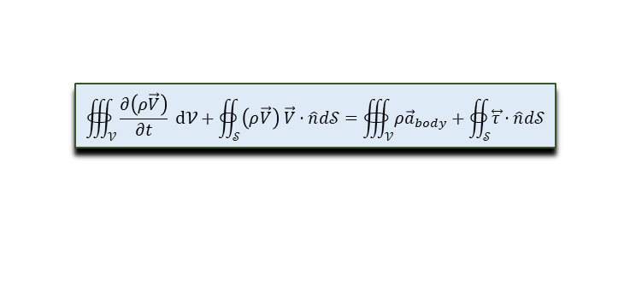
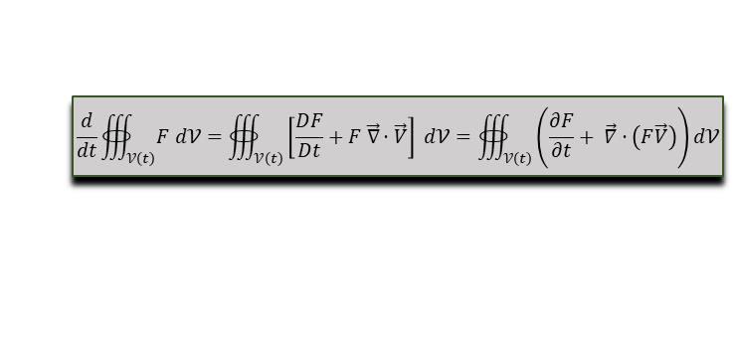


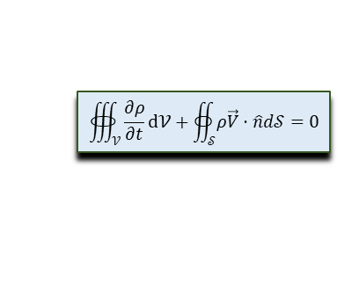



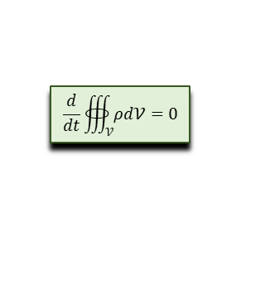

Reynold’s
Transport
$$\frac{1}{𝒱ℴℓ}\frac{D𝒱ℴℓ}{Dt}=\vec{∇}⋅\vec{V}$$
$$\frac{1}{J}\frac{DJ}{Dt}=\vec{∇}⋅\vec{V}$$
$$\frac{d}{dt}∰_{𝒱\left(t\right)}{F d𝒱}=∰_{𝒱\left(t\right)}{\left[\frac{DF}{Dt}+F \vec{∇}⋅\vec{V}\right] d𝒱}=∰_{𝒱\left(t\right)}{\left(\frac{∂F}{∂t}+ \vec{∇}⋅\left(F\vec{V}\right)\right)}d𝒱$$
Cauchy Stress Tensor
(total = pressure + sticky)
Rv
RJ
Rf
$$\overset{⃡}{τ}=−P \overset{⃡}{𝕀}+ \overset{⃡}{σ}$$
Cs
Continuity
Momentum
Total Energy
Internal Energy
$$\frac{Dρ}{Dt}+ρ\vec{∇}⋅\vec{V}=0$$
lc
$$ρ\frac{D\vec{V}}{Dt}=\vec{∇}⋅\overset{⃡}{τ}+ρ{\vec{a}}_{body}$$
lm
$$ρ\frac{D}{Dt}\left(e+\frac{V^{2}}{2}\right)=ρ\left({\vec{a}}_{body}⋅\vec{V}+\dot{Q}\right)+\vec{∇}⋅\left(\overset{⃡}{τ}⋅\vec{V}+\vec{q}\right)$$
le
$$ρ\frac{De}{Dt}=ρ\dot{Q}+\overset{⃡}{τ}∶∇\vec{V}$$
lie
$$\frac{d}{dt}∰_{𝒱}{ρd𝒱}=0$$
Lc
$$\frac{d}{dt}∰_{𝒱}{ρ\vec{V} d𝒱}=∰_{𝒱}{ρ{\vec{a}}_{body} d𝒱}+∯_{𝒮}{\overset{⃡}{τ}⋅\hat{n} d𝒮}$$
Lm
$$\frac{d}{dt}∰_{𝒱}{ρ\left(e+\frac{V^{2}}{2}\right)d𝒱}=∰_{𝒱}{ρ{(\vec{a}}_{body}⋅\vec{V}+\dot{Q}) d𝒱}+∯_{𝒮}{\left(\overset{⃡}{τ}⋅\vec{V}+\vec{q}\right)⋅\hat{n} d𝒮}$$
Le
$$\frac{∂ρ}{∂t}+\vec{∇}⋅\left(ρ\vec{V}\right)=0$$
ec
$$\frac{∂ρ\vec{V}}{∂t}+\vec{∇}⋅\left(ρ\vec{V}\vec{V}\right)=\vec{∇}⋅\overset{⃡}{τ}+ρ{\vec{a}}_{body}$$
em
$$\frac{∂}{∂t}\left[ρ\left(e+\frac{V^{2}}{2}\right)\right]+\vec{∇}⋅\left[ρ\left(e+\frac{V^{2}}{2}\right)\vec{V}\right]=ρ\left({\vec{a}}_{body}⋅\vec{V}+\dot{Q}\right)+\vec{∇}⋅\left(\overset{⃡}{τ}⋅\vec{V}+\vec{q}\right)$$
ee
$$∰_{𝒱}{\frac{∂ρ}{∂t}d𝒱}+∯_{𝒮}{ρ\vec{V}⋅\hat{n}d𝒮}=0$$
Ec
$$∰_{𝒱}{\frac{∂\left(ρ\vec{V}\right)}{∂t} d𝒱}+∯_{𝒮}{\left(ρ\vec{V}\right) \vec{V}⋅\hat{n}d𝒮}=∰_{𝒱}{ρ{\vec{a}}_{body}}+∯_{𝒮}{\overset{⃡}{τ}⋅\hat{n}d𝒮}$$
Em
$$∰_{𝒱}{\frac{∂}{∂t}\left[ρ\left(e+\frac{V^{2}}{2}\right)\right]d𝒱}+∯_{𝒮}{ρ\left(e+\frac{V^{2}}{2}\right)\vec{V}⋅\hat{n}d𝒮}=∰_{𝒱}{ρ{(\vec{a}}_{body}⋅\vec{V}+\dot{Q}) d𝒱}+∯_{𝒮}{\left(\overset{⃡}{τ}⋅\vec{V}+\vec{q}\right)⋅\hat{n} d𝒮}$$
Ee
${\vec{a}}_{body}$ - body accelerations (e.g. gravity or E&M)
$e$ – internal energy
$λ$ – second coefficient of viscosity
$μ$ – dynamic viscosity
$\hat{n}$ - outward surface normal
$P$ – pressure
$Q$ – volumetric heat per mass
$\vec{q}$ - heat flux
$ρ$ – fluid density
$\overset{⃡}{σ}$ – Cauchy stress tensor (aka $\overset{⃡}{T}$)
$𝒮$ – surface
$\overset{⃡}{τ}$ - deviatoric stress tensor
T - temperature
$𝒱$ - volume
$\vec{V}$ - flow velocity
Movement from Lagrangian (particle) and Eulerian (flux) forms is done with the mnemonic:
Flux = U con + Particle
Nf
Newtonian Fluids
$$\overset{⃡}{σ}=λ\left(\vec{∇}⋅\vec{V}\right)\overset{⃡}{𝕀}+μ\left(\vec{∇} \vec{V}+\vec{∇} {\vec{V}}^{T}\right)$$
$$P_{thermo}=−\frac{1}{3}Tr\left(\overset{⃡}{τ}\right)=P−\left(λ+\frac{2}{3}μ\right)\left(\vec{∇}⋅\vec{V}\right)$$
Stokes’s Hypothesis
$$λ=−\frac{2}{3}μ$$
Sh
tp
Incompressibility
Thermodynamic Pressure
Equation Label Key for Fluid equations
lower case first letter – differential form
upper case first letter – integral form
first letter ‘l’ or ‘L’ – Lagrangian or non-conservation form
first letter ‘e’ or ‘E’ – Eulerian or conservation form
second letter ‘c’, ‘m’, ‘e’, ‘ie’ for continuity, momentum, total energy, and internal energy respectively
$$\vec{∇}⋅\vec{V}=0$$
in
Fourier’s Law
$$\vec{q}=−k ∇T$$
Fl

